Slide 1
Deep Reinforcement Learning for Imbalanced
Classification

Slide 2
01
02
TABLE OF CONTENTS
PROJECT GOALS
WHAT IS REINFORCEMENT LEARNING?
03
04
IMPLEMENTATION AND COMPARISON
OTHER IDEAS FOR RL IN BUSINESS

Slide 3
01
GOALS
Predicting purchase based on online customer website behaviour

Slide 4
Goals
Construct a Framework to enable an RL agent to predict customer intention with comparable predictive results to traditional supervised learning methods.
Use the unique structure of RL to manage class imbalance as an alternative to traditional techniques, up/downsampling, etc.
Explore further uses for RL that can bring value to a business.

Slide 5
02
WHAT IS REINFORCEMENT LEARNING?

Slide 6
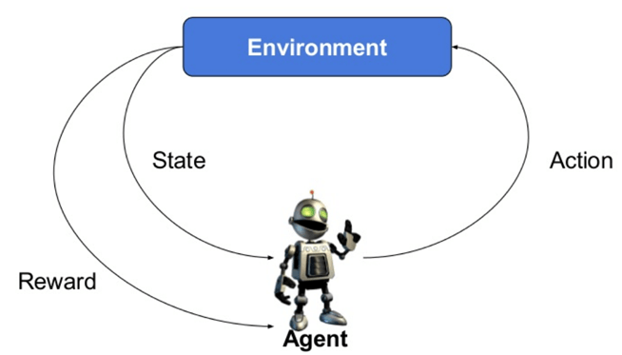
What is Reinforcement Learning?
Reinforcement learning is an area of machine learning concerned with how software agents ought to take actions in an environment in order to maximize some notion of cumulative reward.

Slide 7
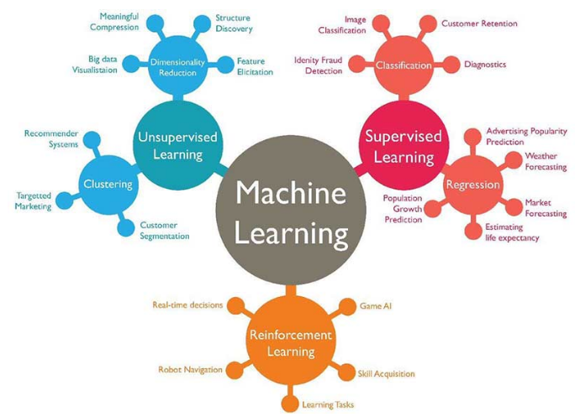
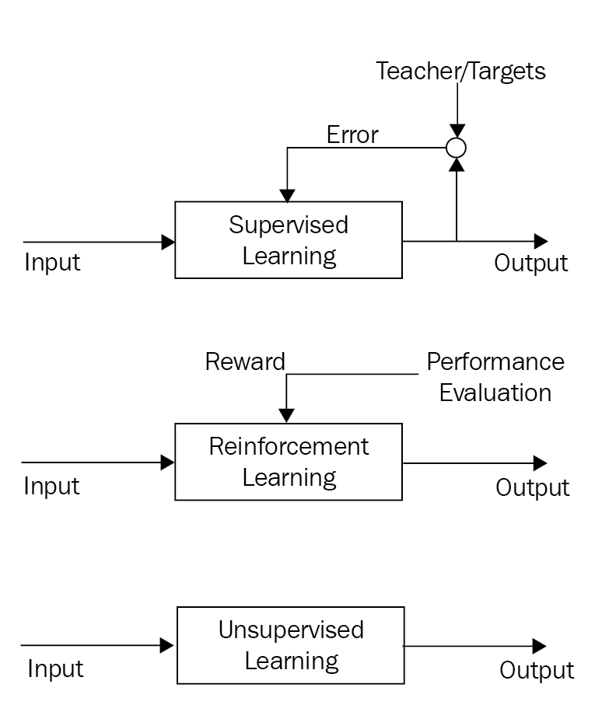
Reinforcement learning or RL is one of three basic machine learning paradigms, alongside supervised learning and unsupervised learning.

Slide 8
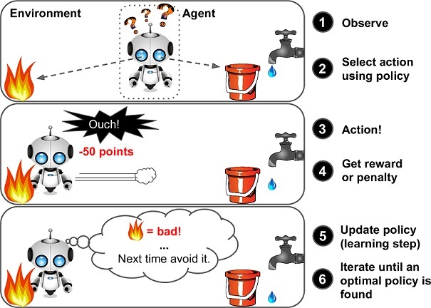
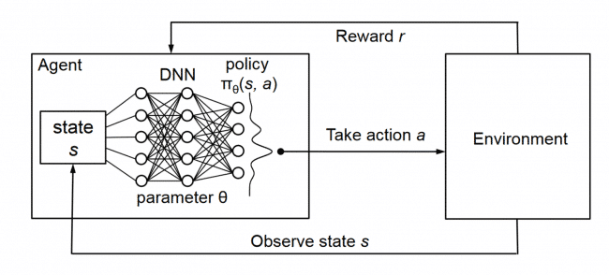

Slide 9
What advantages does it have over other ML techniques such as supervised learning?
What is RL good for?
Continuous learning
Can make predictions while learning
Learns on non-labeled data provided environment has structured an effective reward structure
Reward/Penalty can be shaped for different classes in classification problems to manage class imbalance as well as tune model.
Real-time decisions
Making predictions in a dynamic environment
Navigating and interacting with physical environments where actions/decisions influence the environment

Slide 10
03
IMPLEMENTING REINFORCEMENT LEARNING

Slide 11
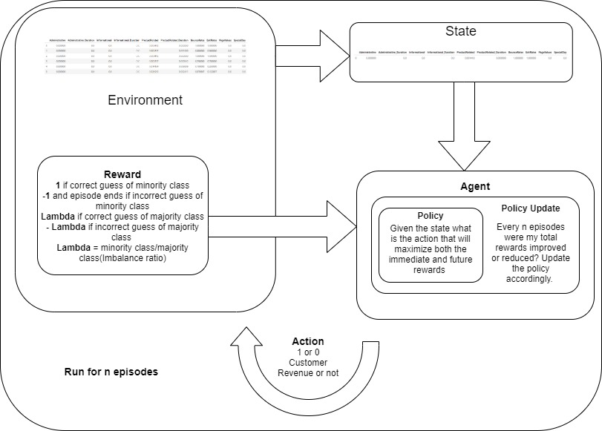

Slide 12
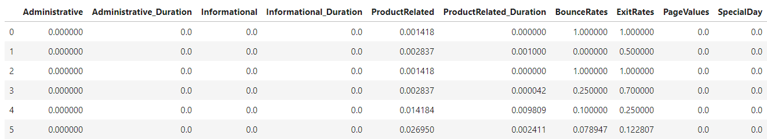

Slide 13
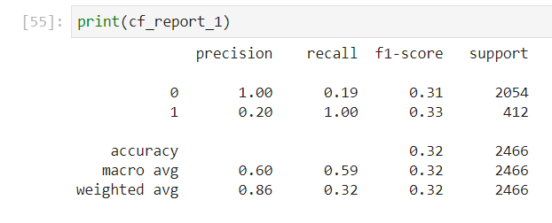
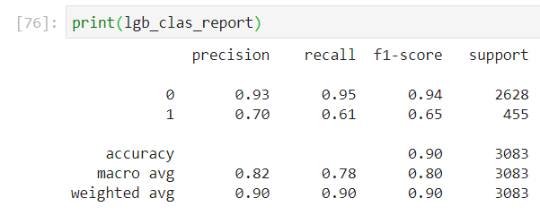
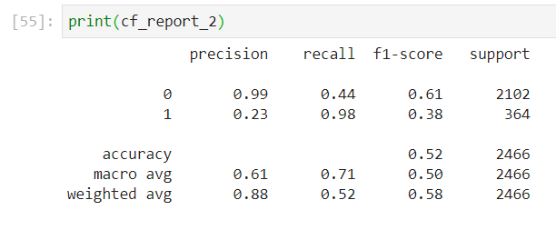
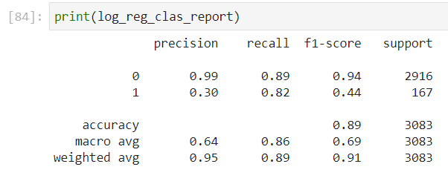
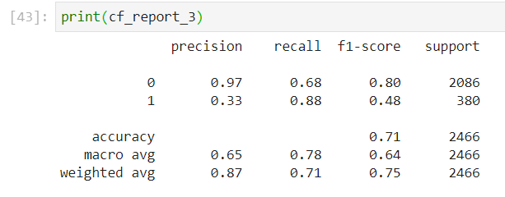
RESULTS
RL MODEL
SUPERVISED LEARNING
Original Lambda for reward
LightGBM Classifier
Lambda x2 for reward
Logistic Regression
Lambda x3 for reward

Slide 14
04
OTHER IDEAS FOR RL IN BUSINESS

Slide 15
eCommerce personalization brought about by reinforcement learning
Optimising space management in a warehouse
Dynamic pricing of products
Robotics in Warehousing and Manufacturing
Trading/Financial Markets
Medical treatments/optimization

Slide 16
THANKS!
Do you have any questions?
booty.jacob@gmail.com
+61 423 461 676
https://github.com/Rubix1
Please keep this slide for attribution.

